Slide 1

Security
Computer System Engineering, Fall 2018. (IPADS, SJTU)
ROP & CFI & More
Yubin Xia

Slide 2
Secret on Device

Slide 3
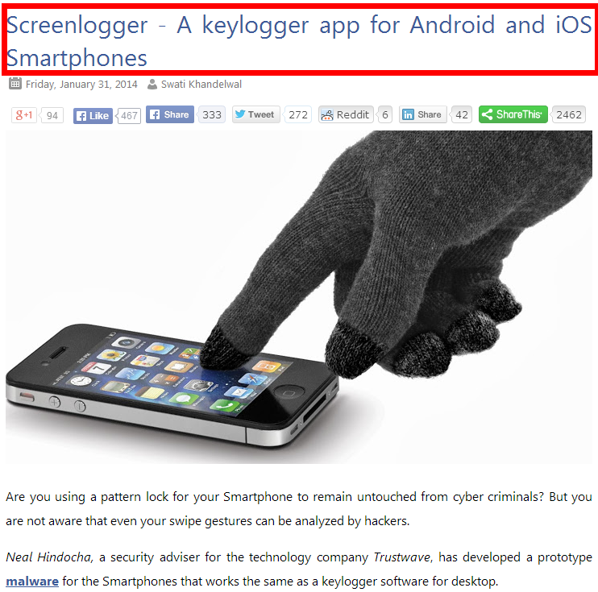
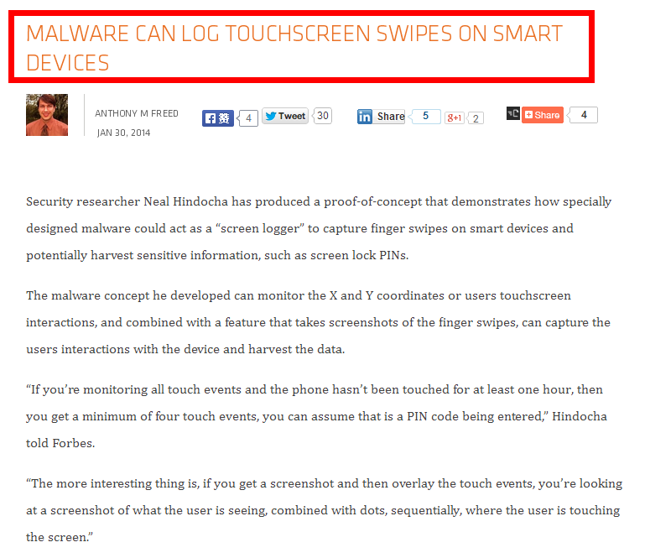
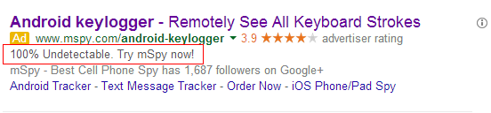
Ways an Attacker Can Steal Your Secrets
KeyLogger: install a KeyLogger/TouchLogger on the phone
Li, Wenhao, et al. "Building trusted path on untrusted device drivers for mobile devices." APSys, 2014.
Notes:
here is a list of how an attacker can steal your secret data. The attacker can install a kerlogger on the phone and steal everything you just input. You can buy that service on ebay.

Slide 4
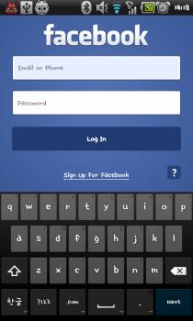
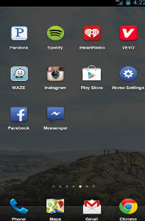
Ways an Attacker Can Steal Your Secrets
KeyLogger: install a KeyLogger/TouchLogger on the phone
Phishing: install a malware and lure the user to enter password
Malicious app
in background,
waiting for the
Facebook app
to launch
Once Facebook app starts, the malicious app will get active and make itself cover the real UI
Bianchi, Antonio, et al. "What the App is That? Deception and Countermeasures in the Android User Interface.", S&P 2015.
Notes:
Or he can install a malware to lure the user to enter password. A typicall malware will run in background...

Slide 5

Ways an Attacker Can Steal Your Secrets
KeyLogger: install a KeyLogger/TouchLogger on the phone
Phishing: install a malware and lure the user to enter password
MemScan: use rootkit and scan the memory for any plaintext
010100101010101000101010101010101010101010101010010101010101010010101010101010101001010011010101010101010101010001001000000101010010010010
The Samsung memory mapping bug: http://forum.xda-developers.com/showthread.php?t=2048511
Notes:
Or, he can just use rootkit and scan the memory for any plaintext

Slide 6
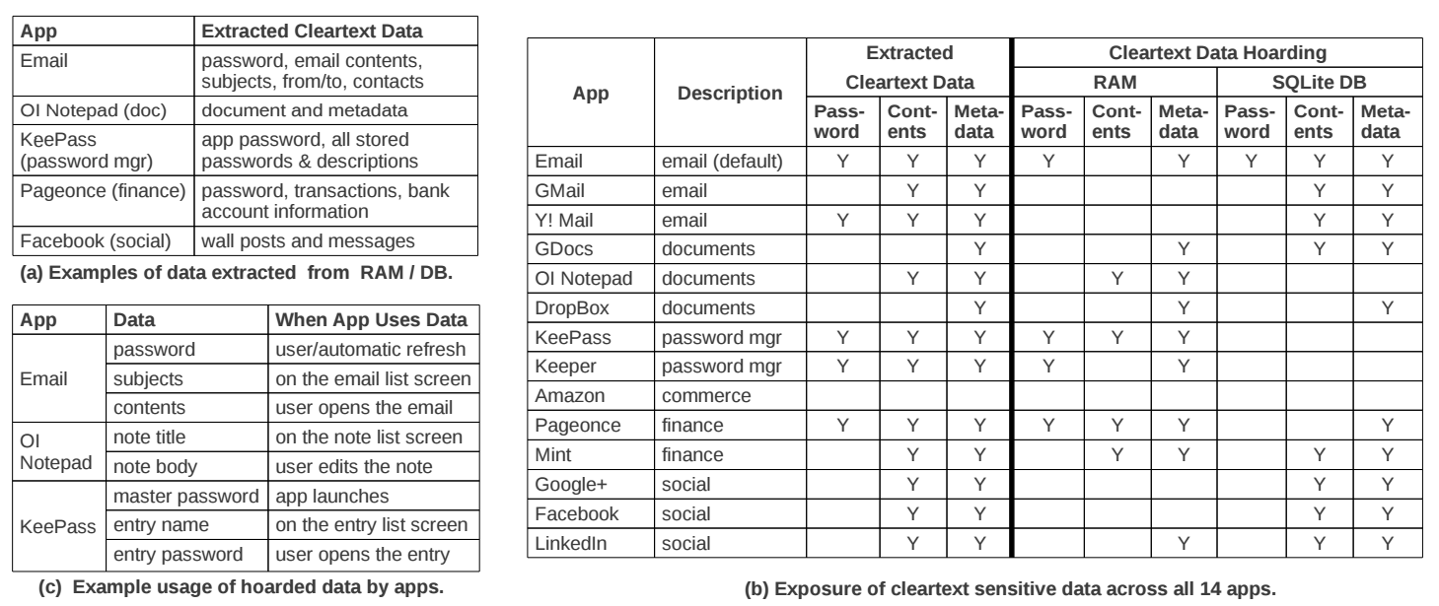
The "Data Residue" Problem
The plaintext of confidential data may exist in memory on a mobile device for a long time
应用对关键数据的保护不够
引CleanOS的数据
Android's default Email app:
has plaintext of password in RAM 10 minutes after login
Tang, Yang, et al. "CleanOS: Limiting Mobile Data Exposure with Idle Eviction." OSDI. 2012.
Notes:
This attack is simple but effective since the memory does contain many secrets. Here is a table from cleanOS, OSDI'12 paper.
It shows that many popular applications will leave residue of critical data in memory for a long time. For example,
the android's default email app,

Slide 7

Ways an Attacker Can Steal Your Secrets
KeyLogger: install a KeyLogger/TouchLogger on the phone
Phishing: install a malware and lure the user to enter password
MemScan: use rootkit and scan the memory for any plaintext
ScreenCapture: get information directly from the screen
Jang, Yeongjin, et al. "A11y Attacks: Exploiting Accessibility in Operating Systems." CCS, 2014.
Notes:
The attacker might also steal your password from screen. On iOS system, once you enter a password, the last character will be displayed for a second. If the attacker can access framebuffer or capture the screen, he can get your password

Slide 8
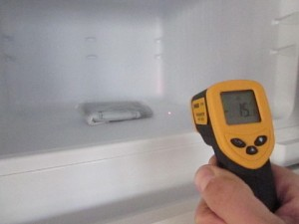
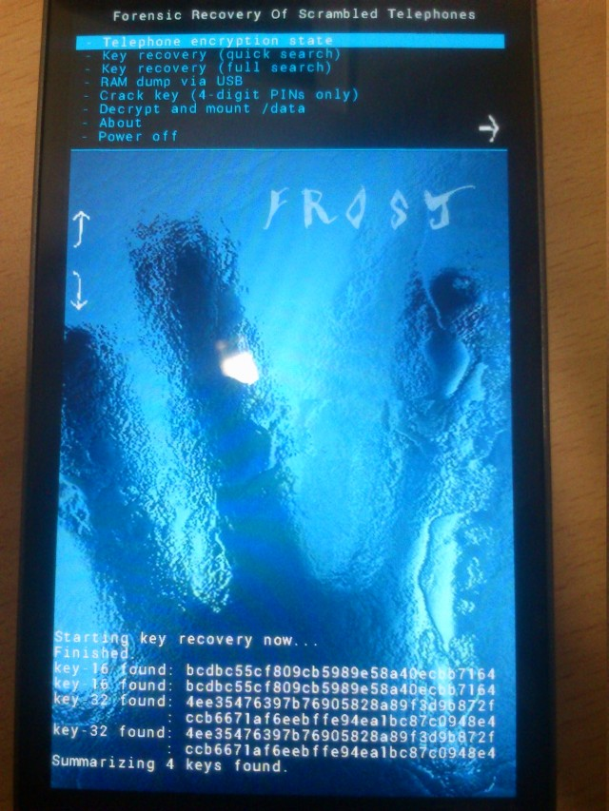
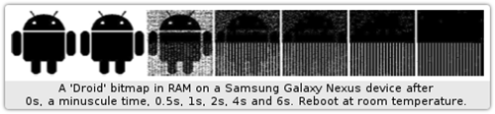
Ways an Attacker Can Steal Your Secrets
KeyLogger: install a KeyLogger/TouchLogger on the phone
Phishing: install a malware and lure the user to enter password
MemScan: using rootkit and scan memory for any plaintext
ScreenCapture: get information directly from the screen
Cold-boot: physically attack that can scan memory to get any plaintext
Müller, Tilo, and Michael Spreitzenbarth. "Frost." Applied Cryptography and Network Security. Springer Berlin Heidelberg, 2013.
Notes:
Cold boot attack is also possible on the mobile device, which just scan the memory to get an plaintext.

Slide 9
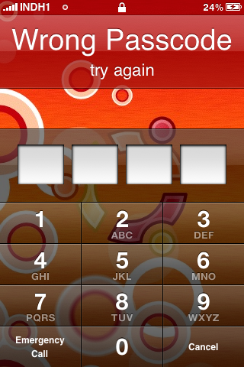
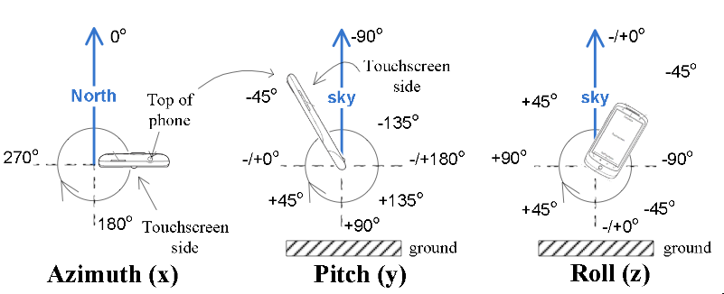
Ways an Attacker Can Steal Your Secrets
KeyLogger: install a KeyLogger/TouchLogger on the phone
Phishing: install a malware and lure the user to enter password
MemScan: using rootkit and scan memory for any plaintext
ScreenCapture: get information directly from the screen
Coldboot: physically scan the memory to get any plaintext
Side-Channel: infer PIN code through motion-detector
Cai, Liang, and Hao Chen. "TouchLogger: Inferring Keystrokes on Touch Screen from Smartphone motion." HotSec. 2011.
Notes:
A even more sophistic attack is to use the motion-detector to guess the user's PIN code, just by learning the relationship between the PIN and phone's inclination when pressing the screen.

Slide 10
CleanOS: Add New Abstraction SDO
Applications create SDOs and add sensitive data to them
CleanOS implements three functions for SDOs:
Tracks data in SDOs using taint tracking
Evicts SDOs to a trusted cloud whenever idle
Decrypts SDO data when it is accessed again
Email App
Email App
Content SDO
Password
SDO
Content
SDO
Password
SDO
evicted
when user reads an email
when the app goes to the background

Slide 11


TinMan: Migrate Confidential Data Access to a Trusted Node
Security-oriented offloading
An app is migrated to the trusted node when accesses cor
The offloading engine is based on COMET ^{[OSDI'12]}
try to access cor
Phone
migrate
migrate back
Trusted-node
access cor
finish access
TinMan: Android without a cor
Notes:
The basic idea is to adopt security-oriented offloading. An app is offloaded to xxx, migrated back...

Slide 12

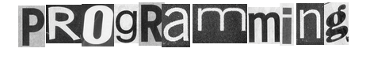

Slide 13
Review: Stack Buffer Overflow
A Typical Buffer Overflow Attack
Inject malicious code in buffer
E.g., shellcode
Overwrite return address to buffer
Once return, the malicious code runs
01010110101010111010
return addr
saved ebp
ebp
0110110101010101010101101010101010101010
void function(char *str) {
char buf[16];
strcpy(buf,str);
}
buf

Slide 14
Shellcode Sample to Open "/bin/sh" (21 bytes)
int main(){
char sc[] = "\x6a\x0b" // push byte 0xb
"\x58" // pop eax (now eax=0xb)
"\x99" // cdq
"\x52" // push edx (now edx=0)
"\x68\x2f\x2f\x73\x68" // push dword 0x68732f2f
"\x68\x2f\x62\x69\x6e" // push dword 0x6e69622f
"\x89\xe3" // mov ebx, esp
"\x31\xc9" // xor ecx, ecx (now ecx=0)
"\xcd\x80"; // int 0x80
((void (*)()) sc)();
}
More can be found on https://www.exploit-db.com
Notes:
Convert Double to Quad的缩写，意为将双字数据扩展为四字。 该指令先把edx的每一位置成eax的最高位（若eax>=0x80000000, 则edx=0xFFFFFFFF；若eax<0x80000000，则edx=0x00000000） ，再把edx扩展为eax的高位。
68: h
73: s
2f: /
2f: /
6e: n
69: i
62: b
2f: /

Slide 15
Defense: DEP (Data Execution Prevention)
Execute Code, not Data
Data areas marked non-executable
Stack marked non-executable
Heap marked non-executable
Hardware enforced (NX: Non-eXecutable)
You can load your shellcode in the stack or the heap…but you can't jump to it

Slide 16
Attack: Code Reuse (instead of inject) Attack
ROP: Return-oriented Programming
Find code gadgets in existed code base
Usually 1-3 instructions, ends with 'ret'
In libc and application, intended and unintended
Push address of gadgets on the stack
Leverage 'ret' at the end of gadget to connect each code gadgets
No code injection
0101011010
0101011010
0101011010
return addr
0101011010
saved ebp
0101011010
0101011010
0101011010

Slide 17
Code Execution – The ROP Way
Mem[v2] = v1
a₃
v₂
a₂
v₁
Desired Logic
Stack
mov %eax v1;
mov %ebx v2;
mov [%ebx], %eax
a₁: pop eax; ret
a₂: pop ebx; ret
a₃: mov [ebx], eax

Slide 18
Code Execution – ROP Way
a₃
v₂
a₂
v₁
a₁
…
argv
argc
return addr
caller's ebp
buf (64 bytes)
argv[1]
buf
Mem[v2] = v1
Desired Shellcode
%ebp
a₁: pop eax; ret
a₂: pop ebx; ret
a₃: mov [ebx], eax
Desired store executed!
%esp

Slide 19
Defense
Hide the binary file
No way to get any gadget
ASLR to randomize the code position
Short for "Address Space Layout Randomization"
Harder to find gadgets
Canary to protect the stack
Try to detect stack overflow (e.g., overflow return address)

Slide 20
ASLR
Change the layout of memory space
Every time when a process is created
Question: how about create by fork?
User-level as well as kernel-level

Slide 21

Canary
Stack
Embed "canaries" in stack frames and verify their integrity prior to function return
Canary is just a random number
Check canary before return, alert if not equal
StackGuard implemented as a GCC patch
Program must be recompiled
Performance overhead: 8% for Apache
Return Addr
Cannary

Slide 22
CFI: Control Flow Integrity

Slide 23
CFI: Control-Flow Integrity
Main idea: pre-determine control flow graph (CFG) of an application
Static analysis of source code
Static binary analysis ← CFI
Execution profiling
Explicit specification of security policy
Execution must follow the pre-determined control flow graph

Slide 24
CFI Motivation
Control flow
Anatomy of many software attacks
Notes:
Many software attacks consists in subverting the control-flow of a binary. Often the virus injects code of its own,. Then by a buffer overflow, it hijacks the program counter to execute the desired code, eventually reaching a point at which the system is compromised (e.g., a shell is executed).

Slide 25
CFI Idea
+
=
Executable
Control-Flow Graph
Self-checking program
Notes:
The idea of CFI is very simple: embed a simple security policy within the executable itself, in the form of a control-flow graph. The executable itself will monitor its execution, and any attempt to deviate from the prescribed CFG will result in an error. Thus, if a virus attempts to step outside the prescribed CFG, it will shut down the program.

Slide 26
Branch Types
Direct Branches
Direct call
Direct jump
Indirect Branches
Return
Indirect call
Indirect jump
In Apache and its libraries
Types | In Binary | Run-time
Direct call | 16.8% | 14.5%
Direct jump | 74.3% | 0.8%
Return | 6.3% | 16.3%
Indirect call | 2.1% | 0.2%
Indirect jump | 0.5% | 68.3%
has 1 target: 94.7%
<= 2 targets: 99.3%
>10 targets: 0.1%

Slide 27
CFI: Binary Instrumentation
Use binary rewriting to instrument code with runtime checks
Inserted checks ensure that the execution always stays within the statically determined CFG
Whenever an instruction transfers control, destination must be valid according to the CFG
Goal: Secure even if the attacker has complete control over the thread's address space

Slide 28
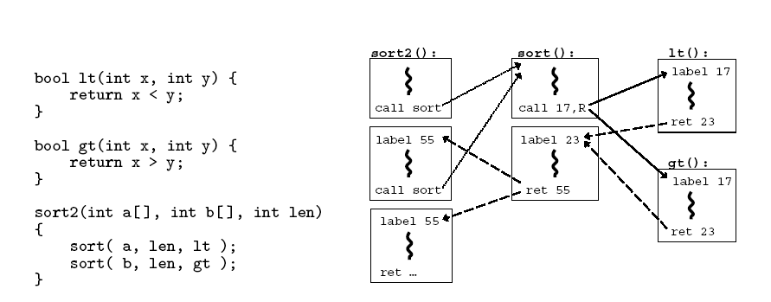
CFG Example

Slide 29
CFI: Control Flow Enforcement
For each control transfer, determine statically its possible destination(s)
Insert a unique bit pattern at every destination
Two destinations are equivalent if CFG contains edges to each from the same source
This is imprecise (why?)
Use same bit pattern for equivalent destinations

Slide 30
CFI: Control Flow Enforcement
Insert binary code that at runtime will check whether the bit pattern of the target instruction matches the pattern of possible destinations

Slide 31
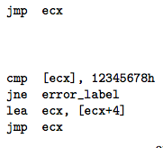
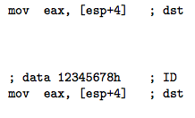
CFI: Example of Instrumentation
Original
Patched

Slide 32
Improving CFI Precision
Suppose a call from A goes to C, and a call from B goes to either C, or D (when can this happen?)
CFI will use the same tag for C and D, but this allows an "invalid" call from A to D
Possible solution: duplicate code or inline
Possible solution: multiple tags

Slide 33
Improving CFI Precision
Function F is called first from A, then from B; what's a valid destination for its return?
CFI will use the same tag for both call sites, but this allows F to return to B after being called from A
Solution: shadow call stack
Maintain another stack, just for return address
Intel CET to the rescue (not available yet)

Slide 34
CFI: Security Guarantees
Effective against attacks based on illegitimate control-flow transfer
Stack-based buffer overflow, return-to-libc exploits, pointer subterfuge
Does not protect against attacks that do not violate the program's original CFG
Incorrect arguments to system calls
Substitution of file names
Other data-only attacks

Slide 35
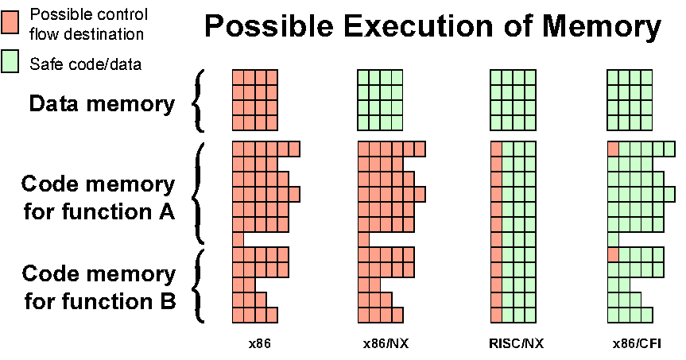
Possible Execution of Memory
[Erlingsson]

Slide 36
Minimize TCB

Slide 37
Review: Principle of Least Privilege
Every program and every privileged user of the system should operate using the least amount of privilege necessary to complete the job.
- Jerome Saltzer

Slide 38
TCB: Trusted Computing Base
TCB is the parts that are trusted
Process never trust another process, but trusts all its threads
OS never trust a process, but trusts hardware
VMM never trust a VM, but trust hardware
Which parts do you trust in your laptop? Your phone?
For most of the time, TCB is the only metric of security
Bugs are inevitable

Slide 39

Root of Trust
There must be some thing to trust
Other trusts are based on the root of trust
Aka., bootstrap
Root of trust can be software or hardware
Software: BIOS, VMM, kernel loader, kernel, etc.
Hardware: TPM, secure processor, etc.
Cogito ergo sum

Slide 40
TPM: Trusted Platform Module
The TPM is the Root of Trust for Reporting
Think: smartcard-like security capability embedded into the platform
The TPM is uniquely bound to a single platform
TPM functions and storage are isolated from all other components of the platform (e.g., the CPU)

Slide 41
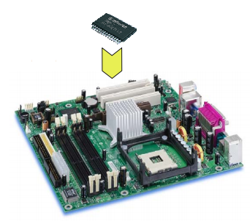
TPM Functions
Sealed storage for private key
Physically safe (for most of the time)
Sign with the private key
For remote attestation
Measure with hash chain
For local trust-chain

Slide 42
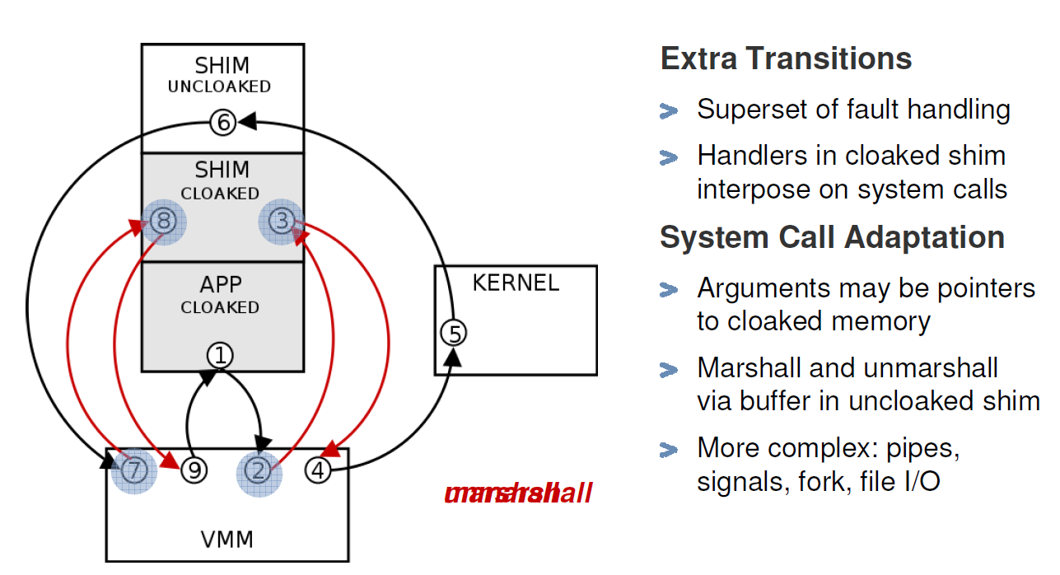
Overshadow: Untrusted OS
Marshall
Unmarshall

Slide 43
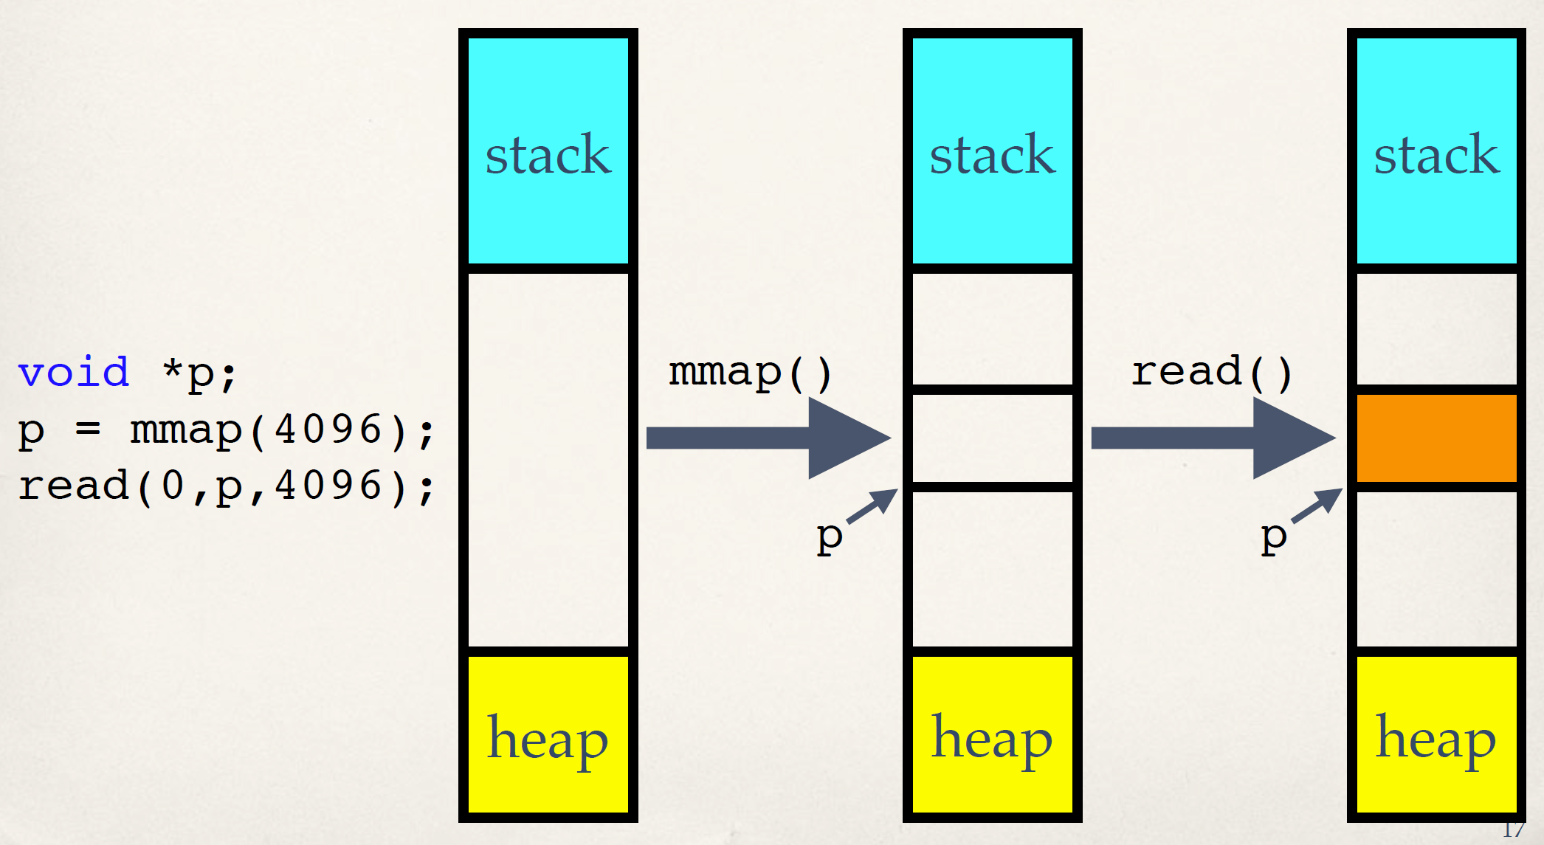
Iago Attack: mmap() (Normal Behavior)

Slide 44
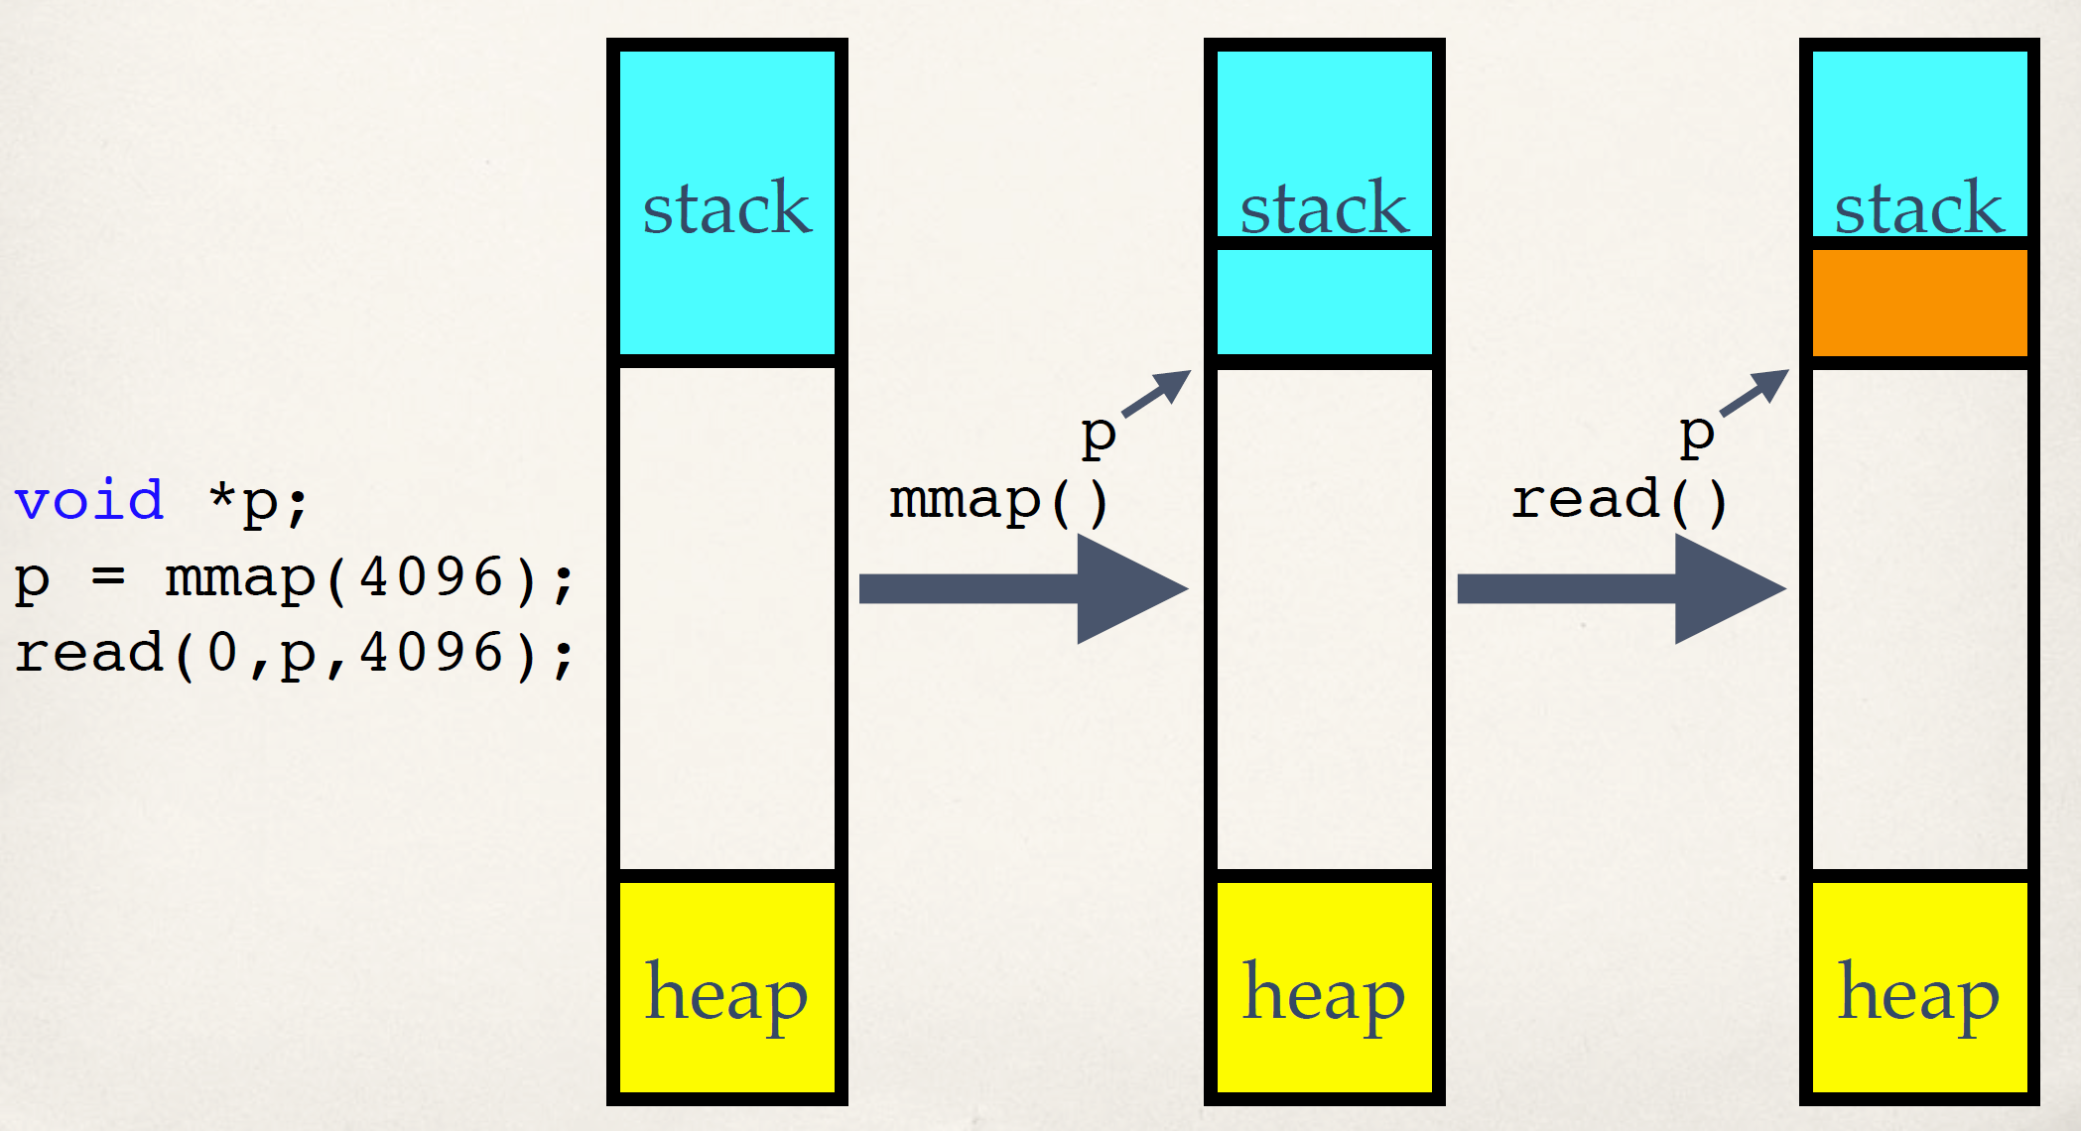
Iago Attack: mmap() (Malicious Behavior)

Slide 45
Untrusted Hypervisor
Control VM
Tools
Guest
VM
Kernel
VMM
Trusted Computing Base
The TCB contains virtualization stack
The TCB size is larger than 9 Million LOCs

Slide 46
Untrusted Hypervisor
One point of penetration leads to full compromise
The virtualization stack should not be trusted
Notes:
Unfortunately, it does grow. Here we show the number of security issues of Xen and Vmware ESX from CVE.
We can see that the number is growing year by year.
In 2012, there’re 39 new security issues found in Xen.
Since in virtualization stack, “one point of …”, we claim that “the virtualization stack …”

Slide 47
Goal of CloudVisor
Defend again curious or malicious cloud operators
To ensure privacy and integrity of a user VM
Be transparent to existing cloud infrastructure
No or little modifications to virtualization stack (OS, Hypervisor)
Minimized TCB
Easy to verify correctness (e.g., formal verification)
Non-goals
DOS, Side-channel attacks, Semantic attacks to VM services from network
Notes:
Awaring of these problems, the goal of cloudvisor is to ...

Slide 48
Virtualization Preliminary: VT-x
VM
Ring 3
Ring 0
guest mode
VM entry
VM exit
host mode
Hypervisor
Notes:
Besides traditional privilege rings on the processor, VT-x introduced a new host mode.
Hypervisor is designed to run in host mode. All privileged operations in guest mode would cause trap into host mode, ie, Vmexit.

Slide 49
Interposition with CloudVisor
VM
Ring 3
Hypervisor
Ring 0
guest mode
VM entry
VM exit
VM entry
VM exit
host mode
Cloudvisor
Notes:
Cloudvisor interposes hypervisor and vms...
In this way, some sensitive states (general purposed registers) could be saved during VMExit.

Slide 50
VM Memory Isolation
Goal: forbid hypervisor access to VM memory
Rules:
When a page is assigned to a VM, CloudVisor changes the ownership of the page
A memory page is only accessible to its owner
Notes:
By leveraging this privileged position, cloudvisor conducts memory isolation by hardware assistance.
The goal of memory isolation is to forbid ...
Cloudvisor also provide strong memory isolation among the hypervisor and guest vms.

Slide 51
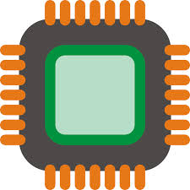

Intel SGX : Isolated Execution
System Memory
CPU Package
Enclave
Access from
OS/VMM
Memory
Encryption
Engine (MEE)
Encrypted
code/data
Snooping
Application keeps its data/code inside the “enclave”
Smallest attack surface by reducing TCB (App + processor)
Protect app’s secret from untrusted privilege software (e.g., OS, VMM)
Notes:
SGX allows part of application code to run in isolation inside an enclave. The enclave region of the main memory is encrypted. The content is only decrypted inside the CPU package using processor specific keys. Thus, even if a malicious adversary has full control over the hardware, it cannot access/modify the enclave. Also, the enclave is protected from other software running in the host, including the OS and hypervisor. In summary, the TCB is the CPU package and the application code running inside and enclave.

Slide 52
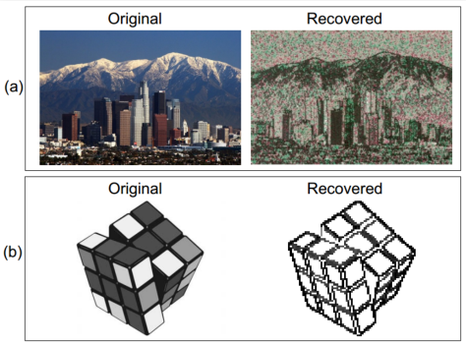
SGX's Vulnerabilities: Side Channel (again!)
Side channel attack
Malicious OS still controls page fault handler
If know the photo processing algorithm, can get the image by monitoring page fault
Not 100% accurate, but still good enough

Slide 53
RowHammer ATtack

Slide 54


RowHammer Attack
Row Buffer
Row 1
0
1
1
1
Row 2
Row 3
Row 4

Slide 55
RowHammer Attack
Row Buffer
Row 1
0
1
1
1
Row 2
Row 3
Row 4

Slide 56
RowHammer Attack
Row Buffer
Row 1
0
0
1
1
Row 2
Row 3
Row 4

Slide 57
Number of Disturbance Errors
In a more controlled environment, we can induce as many as ten million disturbance errors
Disturbance errors are a serious reliability issue
CPU Architecture | Errors | Access-Rate
Intel Haswell (2013) | 22.9K | 12.3M/sec
Intel Ivy Bridge (2012) | 20.7K | 11.7M/sec
Intel Sandy Bridge (2011) | 16.1K | 11.6M/sec
AMD Piledriver (2012) | 59 | 6.1M/sec
Notes:
When we executed the code on four different processors, all four of them yielded errors. Intel Haswell has the most errors, at 23 thousand, because it has the highest rate of accessing DRAM.
Later on, I'll show that we can induce as many as ten million disturbance errors in a more controlled environment.
From this, we conclude that disturbance errors are a serious reliability issue.

Slide 58
Security Implications
Breach of memory protection
OS page (4KB) fits inside DRAM row (8KB)
Adjacent DRAM row → Different OS page
Vulnerability: disturbance attack
By accessing its own page, a program could corrupt pages belonging to another program
Notes:
In addition, they have serious implications for security
When disturbance errors occur, they could breach memory protection. This is because an OS page fits inside a DRAM row. So an error in a different DRAM row means an error in a different OS page.
This opens up a vulnerability to disturbance attacks. Just by accessing its own page, a malicious program could corrupt pages belonging to another program.
And, as shown previously, we constructed a proof-of-concept using only user-level instructions.

Slide 59
Naive Solutions
❶ Throttle accesses to same row
Limit access-interval: ≥500ns
Limit number of accesses: ≤128K (=64ms/500ns)
❷ Refresh more frequently
Shorten refresh-interval by ~7x
Both naive solutions introduce significant overhead in performance and power
Notes:
Based on what we learned from the sensitivity studies, there are two naive solutions that immediately present themselves.
First, we can throttle accesses to the same row. If the access-interval is greater than 500ns, I showed how errors are not induced. We can achieve the same effect by limiting the maximum number of accesses to the same row to be less than 128K, within a refresh interval.
Second, we can refresh the module more frequently. If the refresh-interval is shortened by 7x, I showed how errors can be prevented.
However, both naive solutions introduce significant overhead in both performance and power. Later on, I will propose a much more efficient solution.

Slide 60
Several Potential Solutions
Cost
Make better DRAM chips
Power, Performance
Refresh frequently
Cost, Power
Sophisticated ECC
Cost, Power, Complexity
Access counters
Notes:
Here is a list of four potential solutions to disturbance errors: making better DRAM chips, refreshing more frequently, employing sophisticated ECC schemes, and using hardware counters to track the number of accesses to different rows.
However, all of these solutions incur a large overhead in terms cost, power, performance, and/or complexity.

Slide 61
PARA Solution
PARA: Probabilistic Adjacent Row Activation
Key Idea
After closing a row, we activate (i.e., refresh) one of its neighbors with a low probability: p = 0.005
Reliability Guarantee
When p=0.005, errors in one year: 9.4×10⁻¹⁴
By adjusting the value of p, we can provide an arbitrarily strong protection against errors
Notes:
We provide a more efficient solution, called PARA, which stands for probabilistic adjacent row activation.
The key idea is thus: after closing a row, we activate (i.e., refresh) one of its neighbors with a low probability, for example, p equal to 0.005.
PARA provides a strong reliability guarantee even under the worst-case access patterns to DRAM. When we set p to 0.005, the expected number of errors in one year is 9.4 times 10 to the negative 14. This probability is much lower the failure rate of other hardware components, for example, the hard-disk drive.
And by adjusting the value of p, PARA can provide an arbitrarily strong-degree of protection against errors.

Slide 62
Advantages of PARA
PARA refreshes rows infrequently
Low power
Low performance-overhead
Average slowdown: 0.20% (for 29 benchmarks)
Maximum slowdown: 0.75%
PARA is stateless
Low cost
Low complexity
Notes:
PARA has many advantages. Since it refreshes row infrequently, it has low power and low performance-overhead. Simulated across 29 benchmarks, we saw an average of only 0.2% slowdown and a maximum of only 0.75% slowdown.
In addition, due to its stateless nature, PARA has low cost and complexity.
Therefore, PARA is an effective and low-overhead solution to prevent disturbance errors.

Slide 63
Meltdown & Spectre

Slide 64
Meltdown
Break user/kernel isolation
Allow attacker to read arbitrary kernel data
Hardware bug in architecture
Hard to be fixed by micro-code patch
Exist in almost all Intel CPUs produced in past 20 years

Slide 65


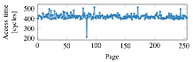
Cache-based side channels
Guess what y is!
x = array[y];
0
1
2
3
4
5
6
7
for (i = 0; i < 8; i++) {
start_timer();
y = array[i];
stop_timer();
}

Slide 66


Meltdown
key = 0x01
Mapped with kernel privilege in page table
Kernel
User
Access key
Permission Error!

Slide 67

Meltdown
key = 0x01
Mapped with kernel privilege in page table
Kernel
User
Meltdown
Can access key!

Slide 68

Meltdown
CPU
Instruction
Effect
Cache
Memory
key = 0x01
Kernel
User
Meltdown

Slide 69
Meltdown
CPU
Instruction
Effect
Permission Error!
1
Load key, %rax
%rax = 1
Reorder
Execution
Load buf[%rax], %rbx
Access buf[1]
2
Cache
Memory
key = 0x01
Kernel
Key = 1
… | buf[0] | buf[1] | buf[2] | … | buf[n] | …
User
Meltdown
buf
(Attack buffer)

Slide 70
Meltdown
CPU
Instruction
Effect
Permission Error!
1
Load key, %rax
%rax = 1
Reorder
Execution
Load buf[%rax], %rbx
Access buf[1]
2
Rollback status
w/o cache status!
Exception
3
Cache
Memory
key = 0x01
Kernel
2
Key = 1
buf[1]
… | buf[0] | buf[1] | buf[2] | … | buf[n] | …
2
User
Access
buf[1]
Fill buf[1]
to cache
Meltdown
buf
(Attack buffer)

Slide 71
Meltdown
CPU
Instruction
Effect
Permission Error!
1
Load key, %rax
%rax = 1
Attacker finds that buf[1] is in the cache, so that key equals to 1!
Reorder
Execution
Load buf[%rax], %rbx
Access buf[1]
2
Rollback status
w/o cache status!
Exception
3
Cache
Memory
key = 0x01
Kernel
2
Key = 1
buf[1]
… | buf[0] | buf[1] | buf[2] | … | buf[n] | …
2
User
Access
buf[1]
Fill buf[1]
to cache
Meltdown
buf
(Attack buffer)

Slide 72
Existing Solution: KPTI
KPTI (Kernel Page Table Isolation)
Two page tables for user and kernel space
User page table only maps user space
Kernel page table maps both user and kernel space
Switch the page table during user/kernel switching
Add latency to syscalls, signal handler,…
Not suitable for the cloud environment
Better one?

Slide 73

Spectre (https://spectreattack.com/spectre.pdf)
Classic side-channel attack w/ deep micro-arch info
1. Attacker primes micro-architecture
E.g, branch predictor or branch target buffer for saving secret
E.g., cache for recalling secret
2: Victim loads secret under mis-speculation
Load should NOT trap (unlike Meltdown)
Still inappropriate if managed language or sandbox
3: Victim saves secret in micro-arch state, e.g., cache
4: Attacker recalls secret from micro-arch state; 4: repeat.

